Slide 1



ImageJ macro programming: Loops and conditions
Robert Haase
With material from
Benoit Lombardot, Scientific Computing Facility, MPI CBG
Gayathri Nadar, Scientific Computing Facility, MPI CBG
Jens Ehrig , CMCB, TU Dresden
Noreen Walker, Scientific Computing Facility, MPI CBG
September 2021

Slide 2
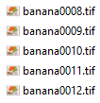
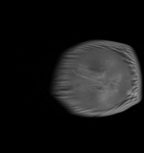
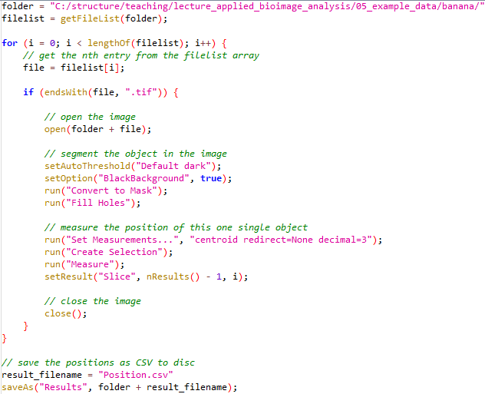
How to eat a banana
the computational way
using ImageJ macro
Remove shell
Repeat until nothing left:
Take a bite
Chew
Swallow
Digest
Access folder
Repeat for all images:
Open an image file
Segment the banana slice
Analyse it
Save measurements
Image data source: Nasreddin Abolmaali, Robert Haase, TU Dresden

Slide 3
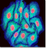

Conditions
Image processing workflows rarely look like this

Slide 4
Conditions
Image processing workflows rather look like this
Conditional statement
Yes
Yes
?
?
?
Yes
No
No
No

Slide 5
Conditions
The if / else statement allows to program alternatives.
Depending on a condition, either the one or the other block is executed.
Curly brackets {} are used to mark where a block starts and ends.
Indentation helps reading blocks.
Note: this line does not end with a ; semicolon!
if ( condition ){
// do something if
// condition is true
}
else{
// do something else if
// condition is false
}
// do in any case

Slide 6
Conditions
Comparison operators always have true or false as results.
// initialise program
quality = 99.5;
// evaluate result
if (quality > 99.9) {
print(”Everything is fine.");
} else {
print(”We need to improve!");
}
Operator | Description | Example
<, <= | smaller than, smaller or equal to¹ | a < b
>, >= | greater than, greater or equal to¹ | a > b
== | equal to¹ | a == b
!= | not equal to¹ | a != 1
¹ these operators work also with string values

Slide 7
Why is indentation important?
Does this program say “Yin” or “Yang”?
Yes, it’s the same program as on the left ☺
// initialise program
a=5;b=3;c=8;
// execute algorithm
d=(a+b)/c;
// evaluate result
if (b>0) {
if (a==5)
{
print("Yin");
}
else
{
if (c<5)
{
}
}
if (d!=0)
{
print("Yang");
}
}
// initialise program
a = 5;
b = 3;
c = 8;
// execute algorithm
d = (a + b) / c;
// evaluate result
if (b > 0) {
if (a == 5) {
print("Yin");
} else {
if (c < 5) {}
}
if (d != 0) {
print("Yang");
}
}
Yin
Yang
yin_yang.ijm

Slide 8
Loops
To repeat actions, you run code in loops
Yes
?
?
?
Yes
Yes
No
No
No
Loop statement

Slide 9
Loops
The for statement allows us to execute some lines of code for several times
// do something
for( <initializer>; <condition>; <iterator>) {
// do something repeatedly
}
// do something
Note: this line does not end with a ; semicolon!

Slide 10
Loops
The for statement allows to execute some lines of code for several times
The initializer is only executed once; at the beginning.
1. start: initialize counter i
// do something
for( i = 0; i < 10; i += 1 ) {
// do something for 10 times
}

Slide 11
Loops
The for statement allows to execute some lines of code for several times
The initializer is only executed once; at the beginning.
The condition is checked every time before the whole block is executed.
2. check condition
If true code is executed
// do something
for( i = 0; i < 10; i += 1 ) {
// do something for 10 times
}

Slide 12
Loops
The for statement allows to execute some lines of code for several times
The initializer is only executed once; at the beginning.
The condition is checked every time before the whole block is executed.
After block execution, the counter is increased.
3. increase counter
// do something
for( i = 0; i < 10; i += 1 ) {
// do something for 10 times
}

Slide 13
Loops
The for statement allows to execute some lines of code for several times
The initializer is only executed once; at the beginning.
The condition is checked every time before the whole block is executed.
After block execution, the counter is increased.
2. check condition
If true: code is executed
// do something once
for( i = 0; i < 10; i += 1 ) {
// do something for 10 times
}

Slide 14
Loops
The for statement allows to execute some lines of code for several times
The initializer is only executed once; at the beginning.
The condition is checked every time before the whole block is executed.
After block execution, the counter is increased.
// do something once
for( i = 0; i < 10; i += 1 ) {
// do something for 10 times
}

Slide 15
Loops
The for statement allows to execute some lines of code for several times
The initializer is only executed once; at the beginning.
The condition is checked every time before the whole block is jumped over.
After block execution, the counter is increased.
2. check condition
If false: exit the loop
// do something once
for( i = 0; i < 10; i += 1 ) {
// do something for 10 times
}

Slide 16
Loops
The for statement allows to execute some lines of code for several times
The initializer is only executed once; at the beginning.
The condition is checked every time
After block execution, the counter is increased.
// do something once
for( i = 0; i < 10; i += 1 ){
// do something at each
// iteration of the loop
}
// do another thing
The counter is initialized
check condition:
if true: execution code in the loop
if false: exit the loop
increase counter
Step 2 and 3 are repeated until the condition is false and the loop exits

Slide 17
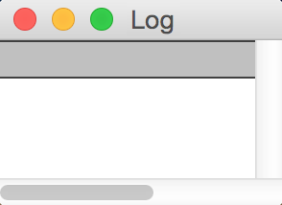
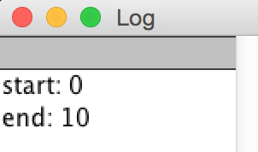
Troubleshooting: Tracing
Tracing means printing something out after every line of code to ensure the path of execution is gone right.
print("start: " + start);
print("end: " + end);
// print numbers
for ( i = start; i > end; i += 1 ) {
print("is this ever printed?");
if (i > 5) {
print(i);
}
}
print("start: " + start);
print("end: " + end);
// print numbers
for ( i = start; i > end; i++ ) {
if (i > 5) {
print(i);
}
}
// print numbers
for ( i = start; i > end; i++ ) {
if (i > 5) {
print(i);
}
}
?

Slide 18
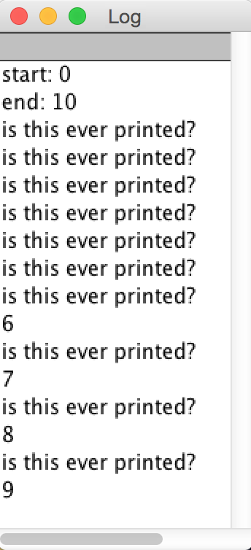
Troubleshooting: Tracing
Tracing means printing something out after every line of code to ensure the path of execution is gone right.
print("start: " + start);
print("end: " + end);
// print numbers
for ( i = start; i < end; i += 1 ) {
print("is this ever printed?");
if (i > 5) {
print(i);
}
}
print("start: " + start);
print("end: " + end);
// print numbers
for ( i = start; i > end; i++ ) {
if (i > 5) {
print(i);
}
}
// print numbers
for ( i = start; i > end; i++ ) {
if (i > 5) {
print(i);
}
}
Don’t forget to remove the “traces” after you found the bug!

Slide 19
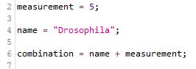
Variables
Variables are memory blocks where you can store stuff
Computer memory
measurement
5
name
“Drosophila”
combination
“Drosophila5”

Slide 20
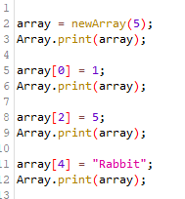
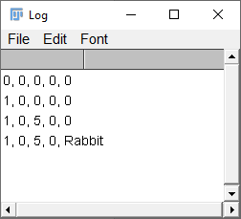
Arrays
Arrays are variables, where you can store multiple stuff
Computer memory
array
0
0
0
0
0
array
1
0
0
0
0
array
1
0
5
0
0
array
1
0
5
0
Rabbit
arrays_access.ijm

Slide 21
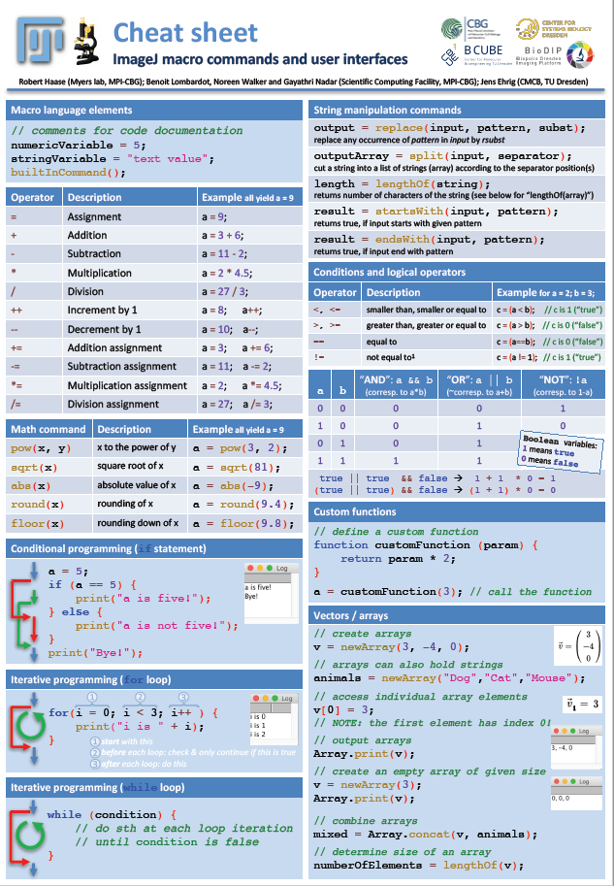
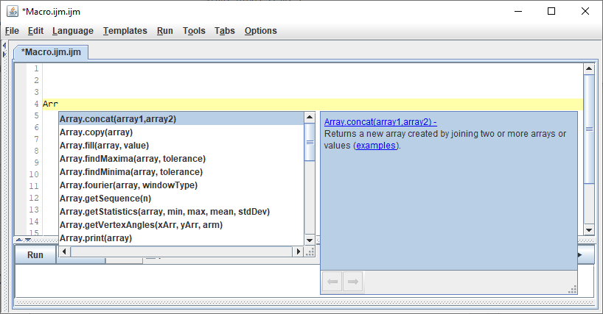
Arrays
Arrays can be initialized with values (more than 1)
v = newArray(3, -4, 0);
animals = newArray("dog", "cat", "mouse");
Arrays can be concatenated:
mixed = Array.concat(v, animals);
Find out what else you can do with Arrays by starting typing:

Slide 22
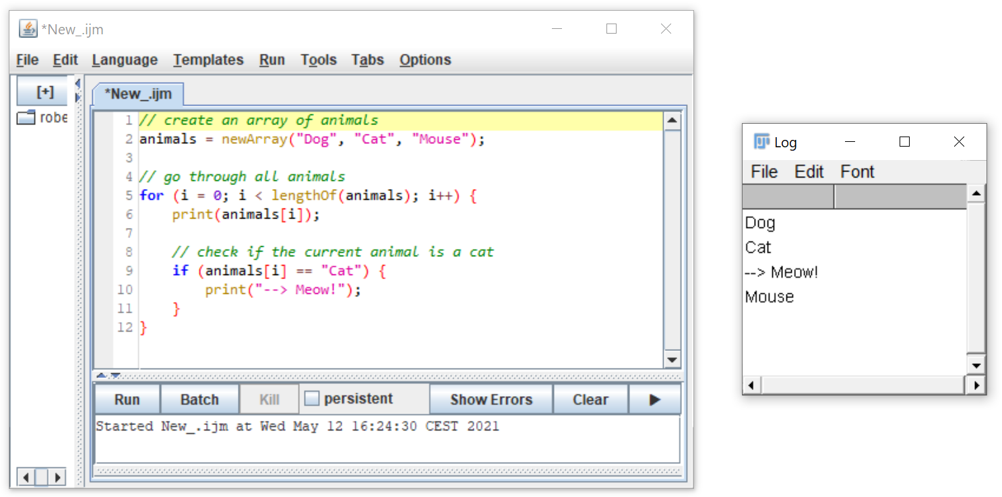
Learning by doing!

Slide 23
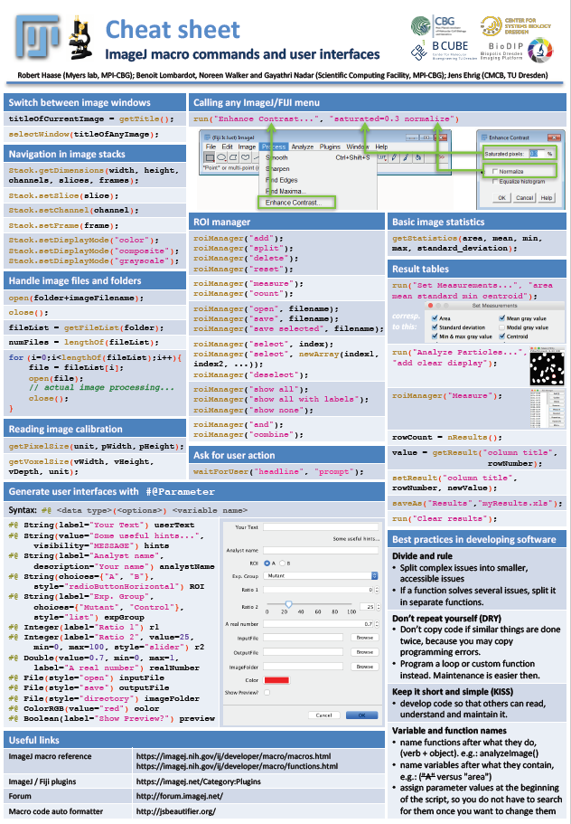
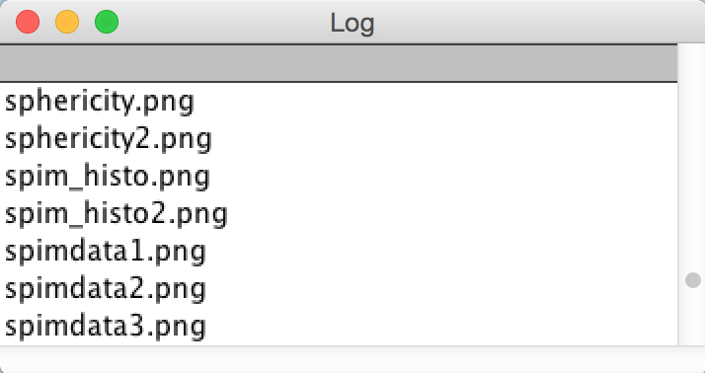
Working with image files in a folder
The files in a folder are represented as an array[]
// initialise program
foldername = "/Users/rhaase/temp/";
// get all files in the folder as array
list = getFileList( foldername );
// print out the array; item by item
for (i = 0; i < lengthOf(list); i += 1 ) {
filename = list[i];
print( filename );
}
Built-in command | Description | Parameters
filenameList = getFileList(foldername) | return a list of file names | location name of the folder

Slide 24
Demo macro recorder

Slide 25
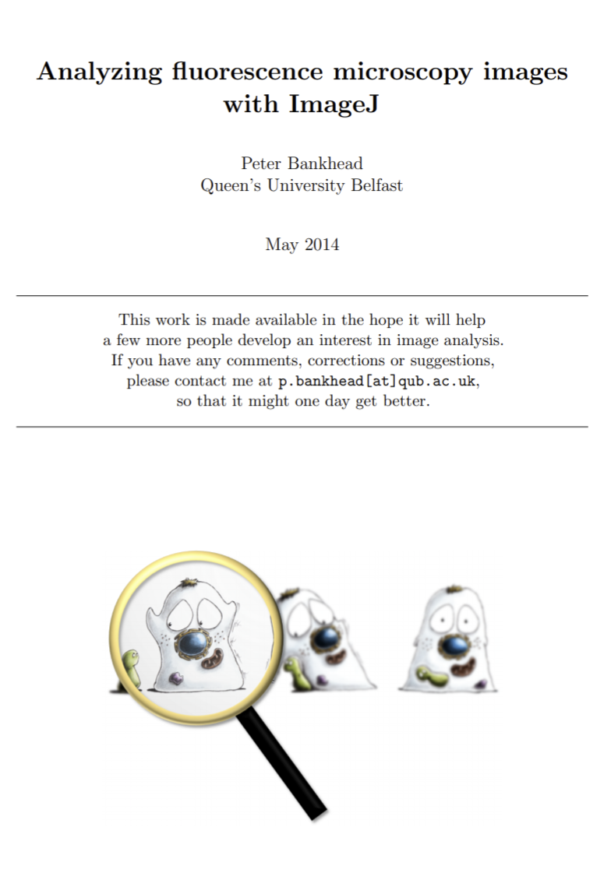
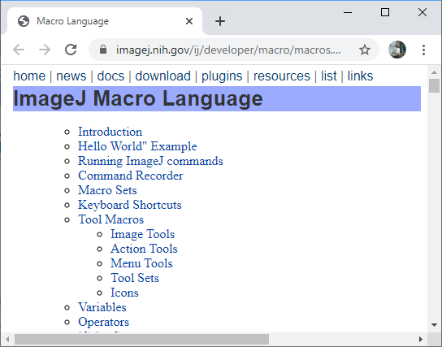
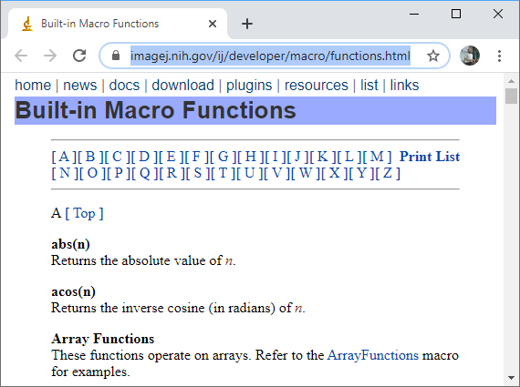
Online resources
Important ImageJ macro websites
https://imagej.nih.gov/ij/developer/macro/macros.html
https://petebankhead.gitbooks.io/imagej-intro/content/
https://imagej.nih.gov/ij/developer/macro/functions.html

Slide 26
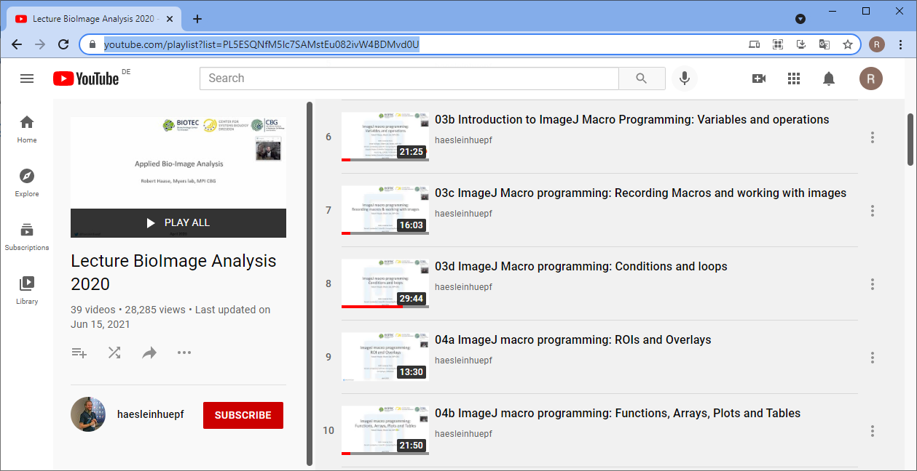
Online resources
Bio-image analysis lecture (2020)
https://www.youtube.com/playlist?list=PL5ESQNfM5lc7SAMstEu082ivW4BDMvd0U

Slide 27
Cheat sheets!
https://github.com/BiAPoL/imagej-macro-cheat-sheet
Thanks to
Benoit Lombardot,
Gayathri Nadar,
Jens Ehrig and
Noreen Walker for contributing to and maintaining this document!

Slide 28
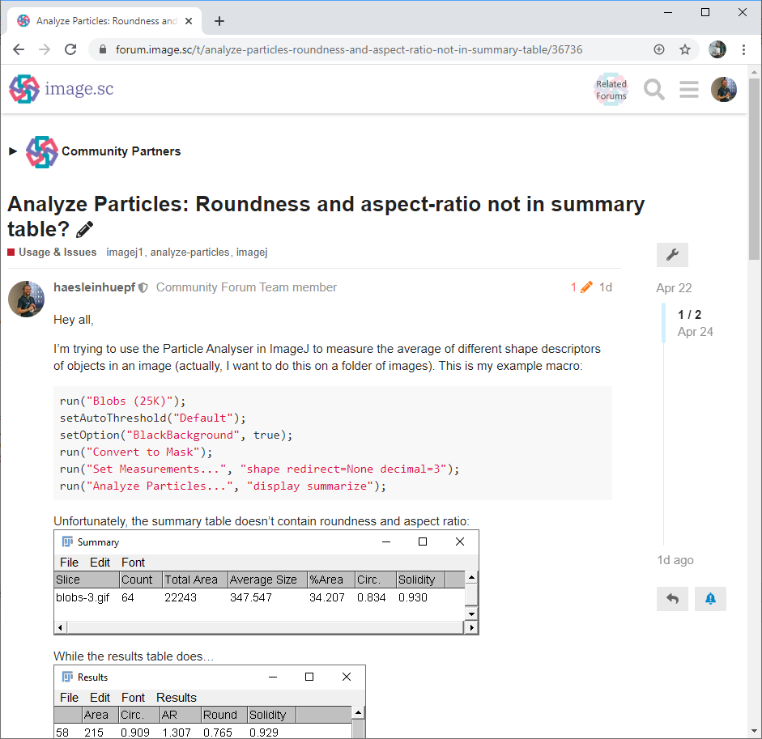
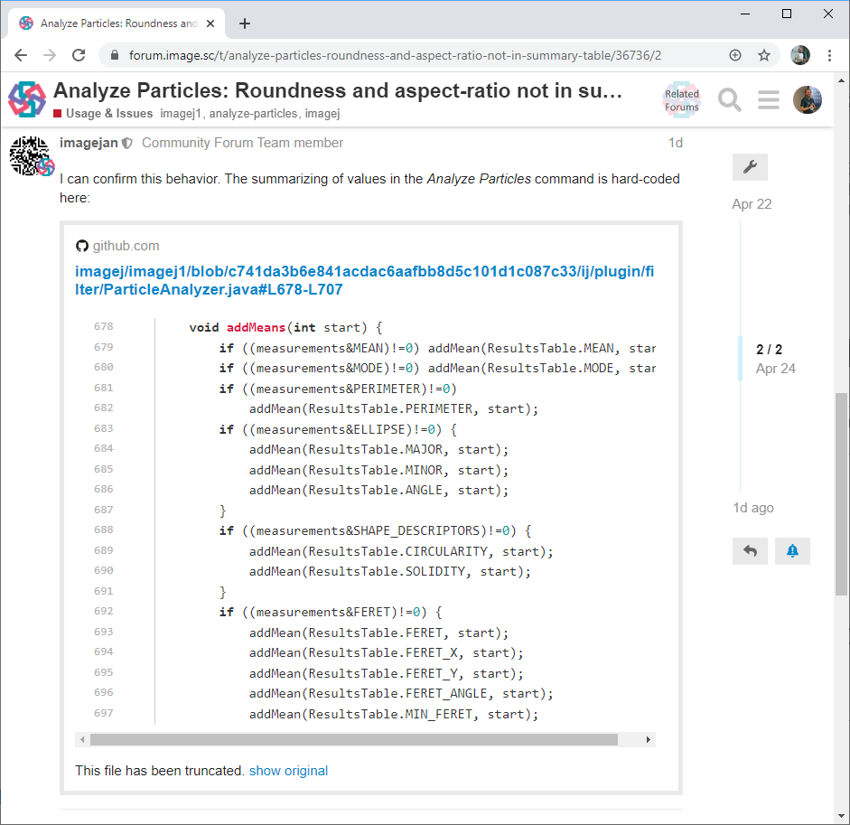

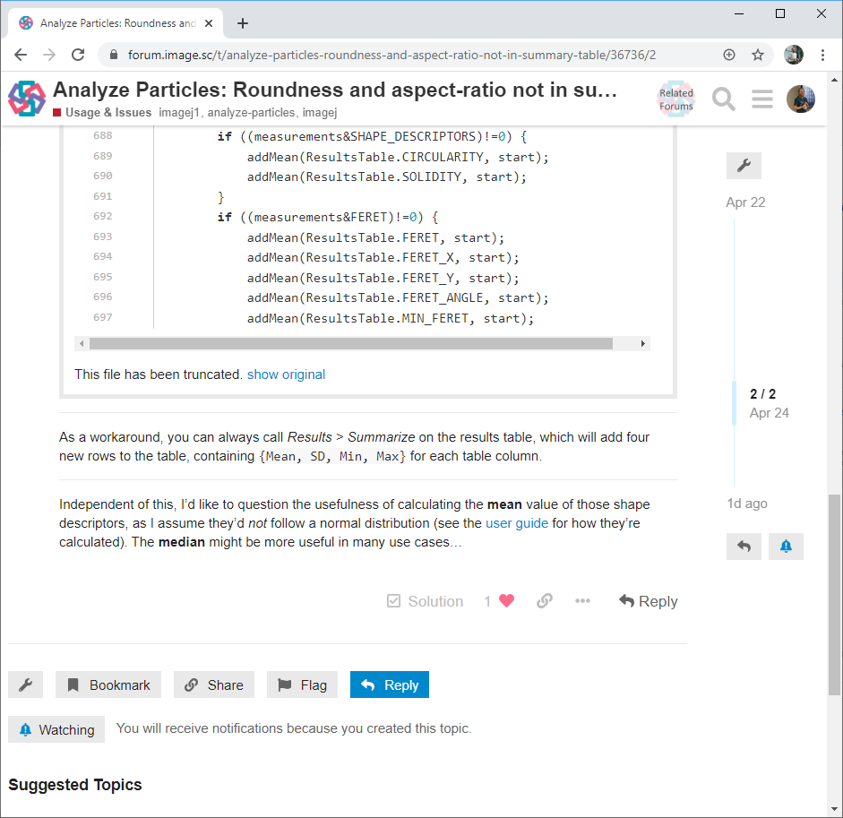
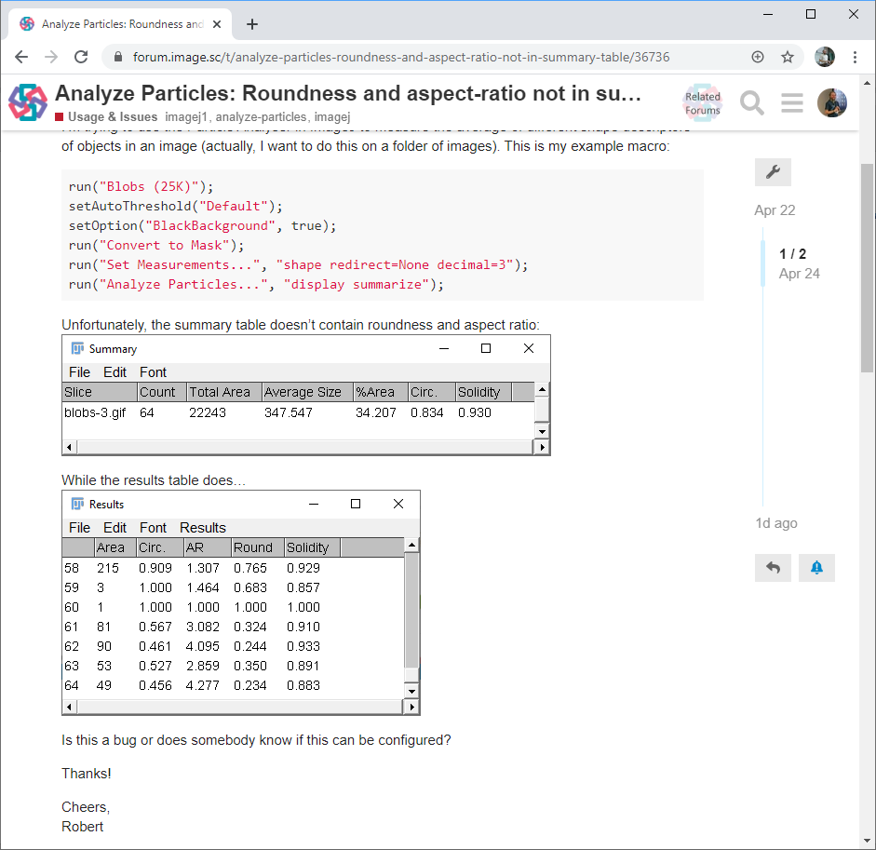
The image science forum!
Mean aspect ratio or roundness are not given in ImageJs summary table
Jan Eglinger
BioImage Analyst
Core facility for
Advanced Imaging
and Microscopy
(FMI Basel)
https://forum.image.sc/t/analyze-particles-roundness-and-aspect-ratio-not-in-summary-table/36736/2

